Slide 1
Using policy gradient to improve social learning
By Nima

Slide 2
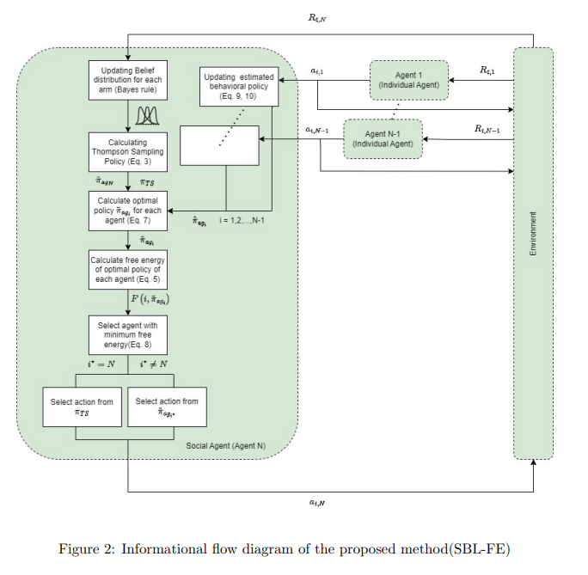
Starting point: Social Bandit
Observe others’ experiences
Interact with env
Improve your policy/value network
Update belief models
Choose an agent based on a criteria
Adapt its policy

Slide 3
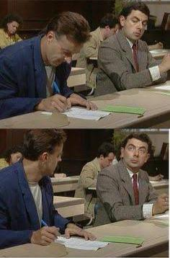
Extension to MDPs
In this setting, we assume that the computation cost is much cheaper than the exploration cost.
Our goal is to detect expert agents and then try to model (clone) their behavior and interact with the environment using this model. Meanwhile, our agent uses these expert trajectories to improve its policy and eventually put the model aside.

Slide 4

Method 1
Using SAC as a base algorithm for our agent. It trains an actor and a Q network for us.
Using BC to create models of other agents based on (state, action) pairs in a supervised manner. These models are actors.
Up until now, we have one Q network and n+1 actors.
We start training and in each state, the state is given to all actors, and actions are produced. Then all of these actions along with the state are fed into our Q network and the action with the maximum q value is selected.
An untrained Q network won’t prefer expert actions
Our policy is trained using action values from our Q network and our Q network is trained using next_actions produces by our policy network. So, our policy network learns to choose actions that favor Q network and gets selected almost all the time.
So, it gives no superiority over training alone.

Slide 5
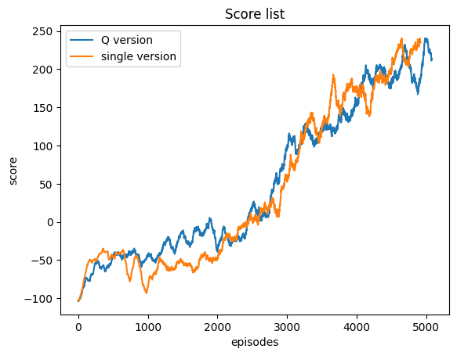

Slide 6

Method 2 PG inspired
In this setting we use the idea of discrete policy gradient to choose between agents.
SAC and BC are the same. The only difference is in agent selection.
We give each agent (including ourself) a score, which is the normalized mean of their recent episodic reward.
These scores then go through a SoftMax function and turn into logits.
These logits are used to form a distribution over agents.
In Each episode (not state), an agent is taken from the distribution and runs the environment.
This method should choose the expert agent most of the time. And provide our agent with expert trajectories that help it learn faster and gradually take over the expert.
The SAC algorithm is not suited to learn from offline data. This is because of the distributional shift between offline data and online data from our interactions.
The algorithm fails totally.

Slide 7
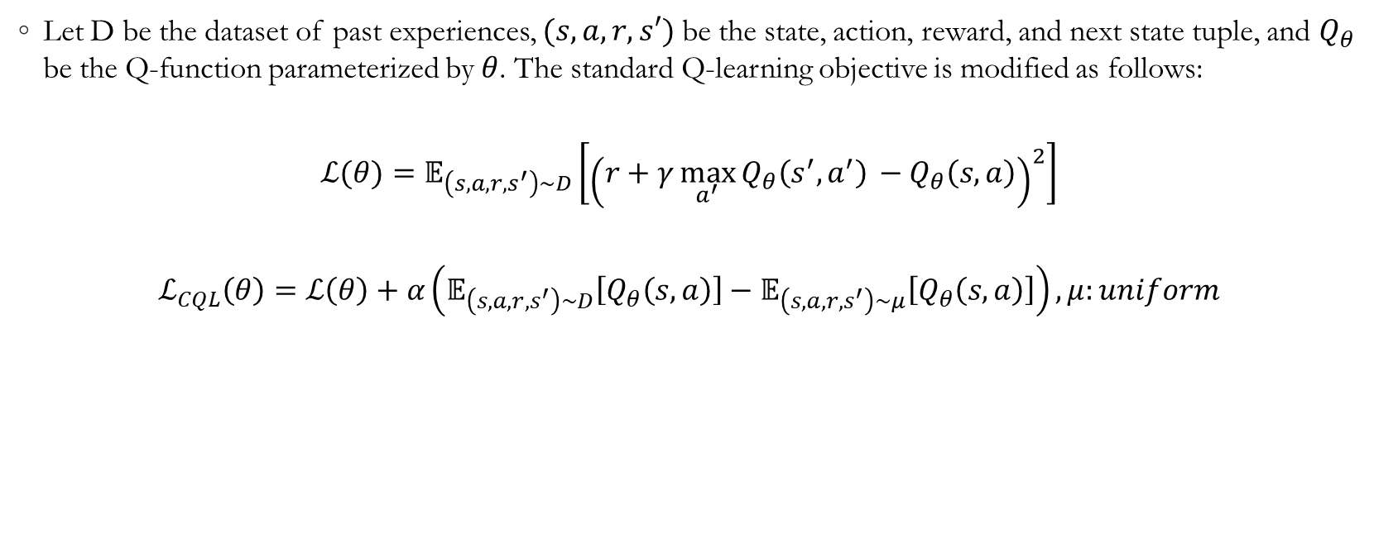
Conservative Q-Learning
Let D be the dataset of past experiences, $(s,a,r,s′)$ be the state, action, reward, and next state tuple, and $Q_{θ}$​ be the Q-function parameterized by $θ$. The standard Q-learning objective is modified as follows:
$$ℒ(θ)=𝔼_{\left(s,a,r,s^{′}\right)∼D}​\left[{\left(r+γ\max_{a^{′}}{Q_{θ}\left(s^{′},a^{′}\right)}​−Q_{θ}​\left(s,a\right)\right)}^{2}\right]$$
$$ℒ_{CQL}\left(θ\right)=ℒ\left(θ\right)+α\left(𝔼_{\left(s,a,r,s^{′}\right)∼D}\left[Q_{θ}​\left(s,a\right)\right]−𝔼_{\left(s,a,r,s^{′}\right)∼μ}\left[Q_{θ}​\left(s,a\right)\right]\right), μ:uniform$$
Kumar, A., Zhou, A., Tucker, G., & Levine, S. (2020). Conservative Q-Learning for Offline Reinforcement Learning. In Advances in Neural Information Processing Systems 33 (NeurIPS 2020) cited by 1523

Slide 8
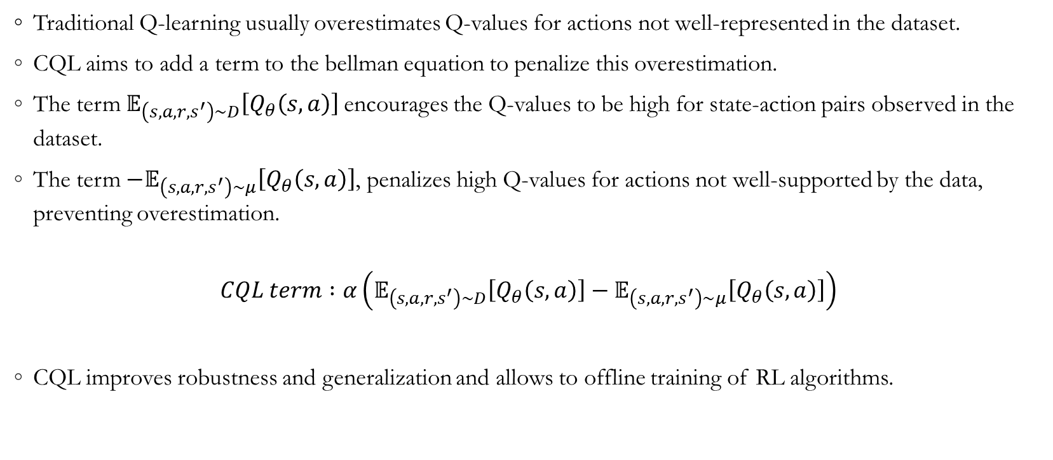
Conservative Q-Learning
Traditional Q-learning usually overestimates Q-values for actions not well-represented in the dataset.
CQL aims to add a term to the bellman equation to penalize this overestimation.
The term $𝔼_{\left(s,a,r,s^{′}\right)∼D}\left[Q_{θ}​\left(s,a\right)\right]$encourages the Q-values to be high for state-action pairs observed in the dataset.
The term $−𝔼_{\left(s,a,r,s^{′}\right)∼μ}\left[Q_{θ}​\left(s,a\right)\right]$, penalizes high Q-values for actions not well-supported by the data, preventing overestimation.
$$CQL term :α\left(𝔼_{\left(s,a,r,s^{′}\right)∼D}\left[Q_{θ}​\left(s,a\right)\right]−𝔼_{\left(s,a,r,s^{′}\right)∼μ}\left[Q_{θ}​\left(s,a\right)\right]\right)$$
CQL improves robustness and generalization and allows to offline training of RL algorithms.

Slide 9
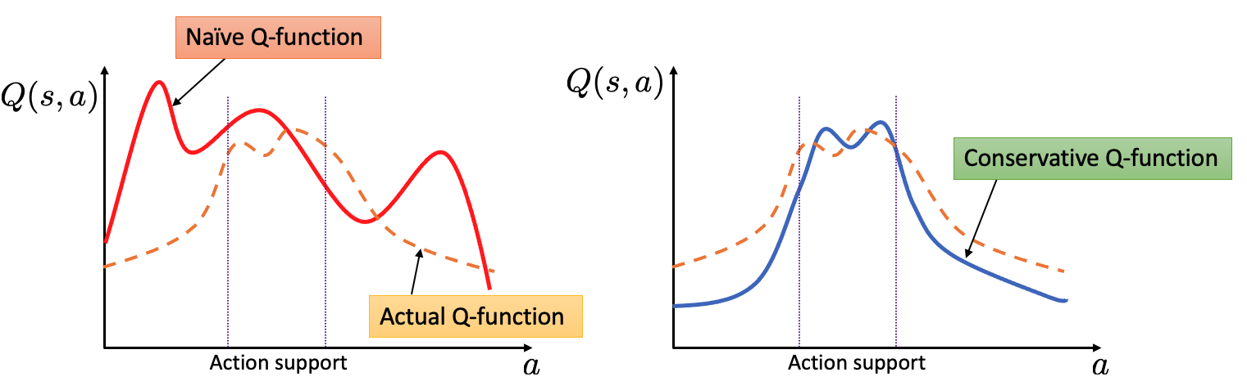
Conservative Q-Learning
It replaces the Q-values with their lower bounds

Slide 10
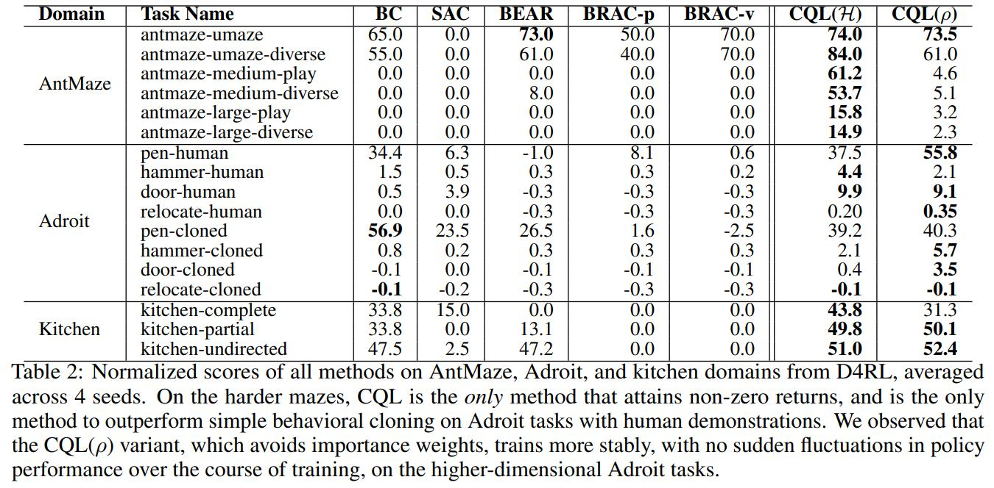
Results

Slide 11
PG Inspired Updated
The setting is identical to the previous version, with a CQL term added to Q network loss.
Observe others’ experiences
Interact with env
Improve your policy/value network
SAC+CQL
Update belief models
Choose an agent based on a criteria
Adapt its policy
BC
PG
BC

Slide 12
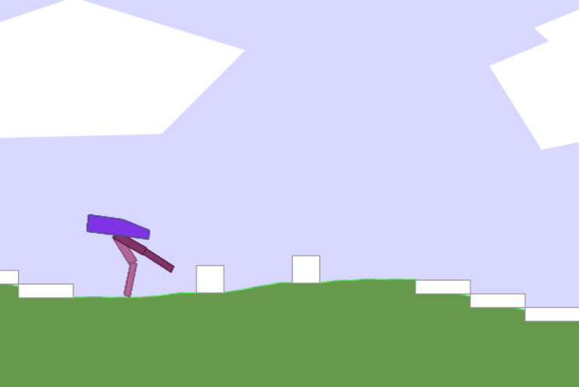
Experiment setting
Environment: bipedal walker v3 hardcore
Social agents: {hardcore expert, flat version expert, untrained} / {flat version expert, untrained}

